Slide 1
Sportivo Academy Management System
I3305 INTERFACE GRAPHIQUE PROJECT
BY : - HUSSEIN B. FAWAZ
-ABBAS SHERKAWI
Dr. Bilal Kanso

Slide 2
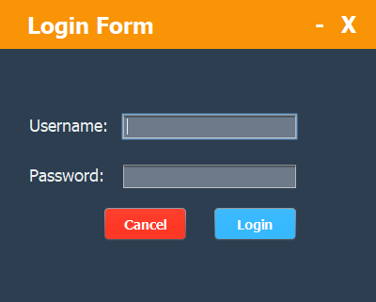
Log in Page :
Only the Administrator has the right to access the system
The Administrator should enter their username and password

Slide 3
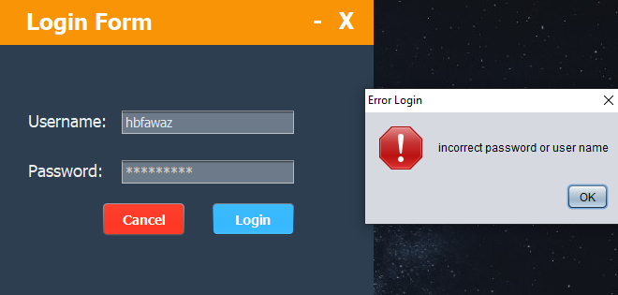
Log in Page Failed:
If the administrator enters a wrong username and/or password, an error message appears (JoptionPane).

Slide 4
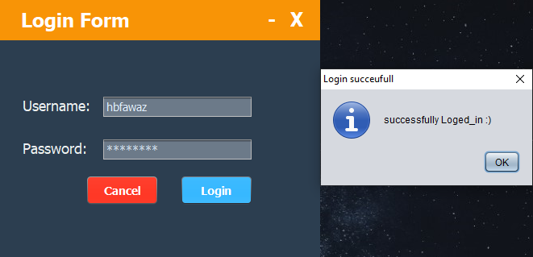
Log in Page Successful:
When the administrator enters the correct username and password, a successful JoptionPane appears. When the admin clicks “OK”, the main frame of the system shows up.

Slide 5
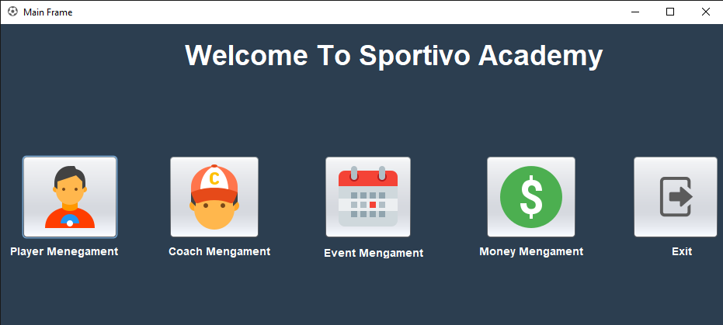
Main Frame:
The main frame contains :
-A ”Player Management” button
-A ”Coach Management” button
-A ”Event Management” button
-A ”Money Management” button
-A ”Exit” Button that quit the system

Slide 6
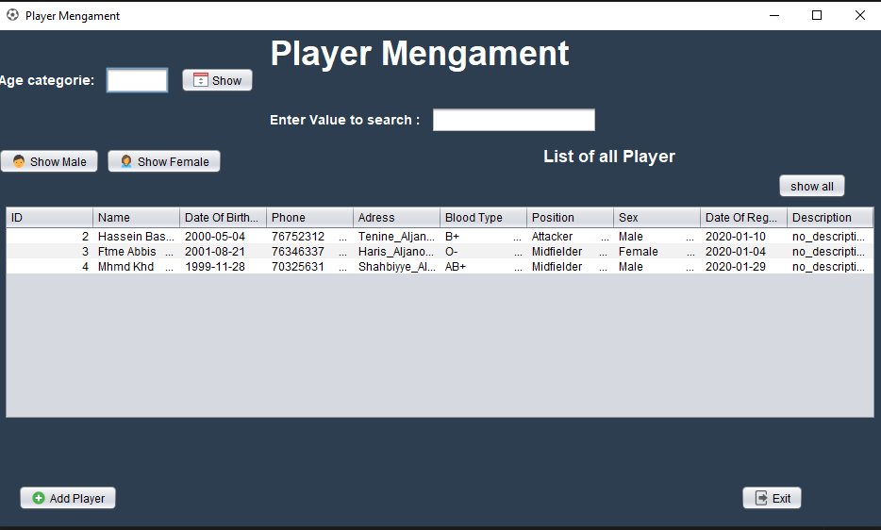
Player Management:
This frame shows all the players registered in the database using a table.
This frame contains :
- A “show all” button .
- A button that shows only male players .
- A button that shows only Female players.
A text field to filter the players based on the age category (2009-2010-….).
A text field to search for a specific player .
An “Add Player” button that allows the admin to register a new player.

Slide 7
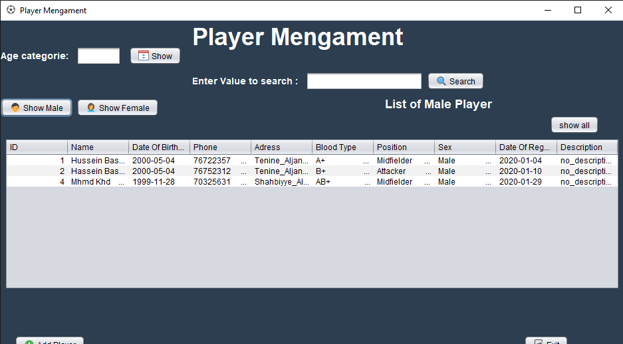
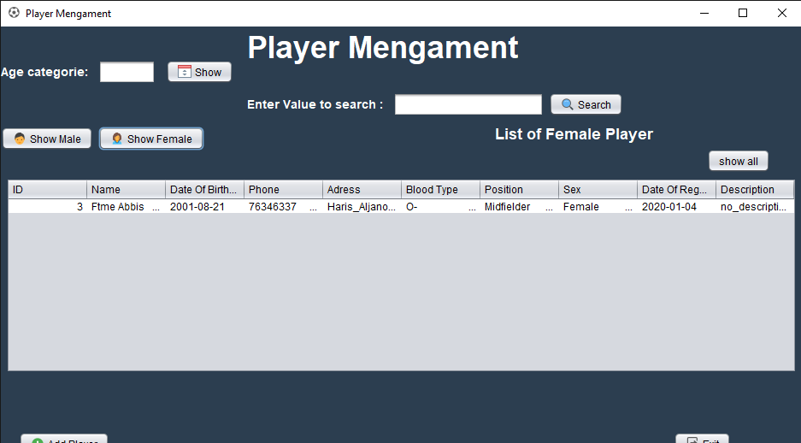
Player Management (Male or Female)
If we click on “Show Male”,
only male players will be shown.
If we click on “Show Female”,
only female players will be shown.

Slide 8
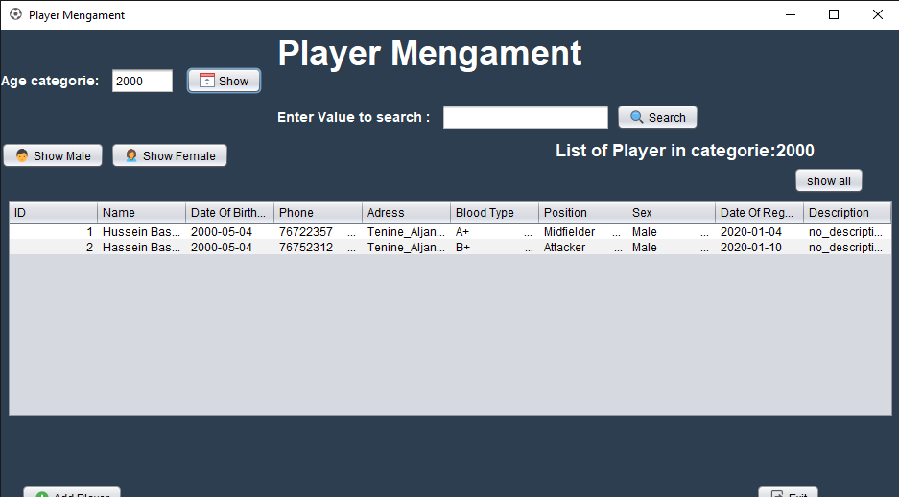
Player Management Based on Age Category
When we enter a birth year (age category, e.g. 2000), and we click the “show” button, only the players with the specified age category (2000) are shown in the table

Slide 9
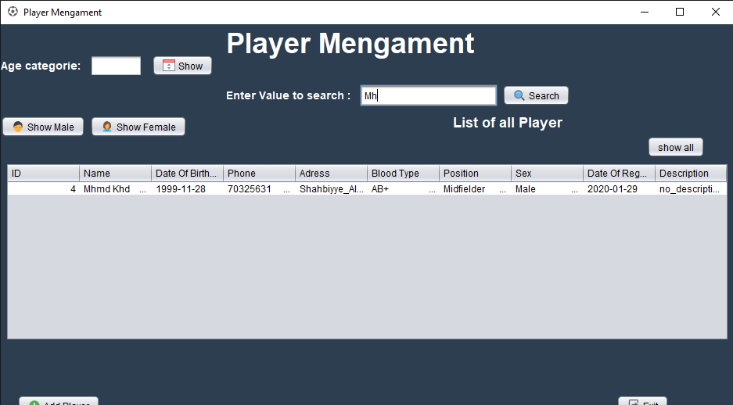
Player Management Using the Search Field
The administrator can enter the name or any other field from the table. The system will automatically show the result of the search.

Slide 10
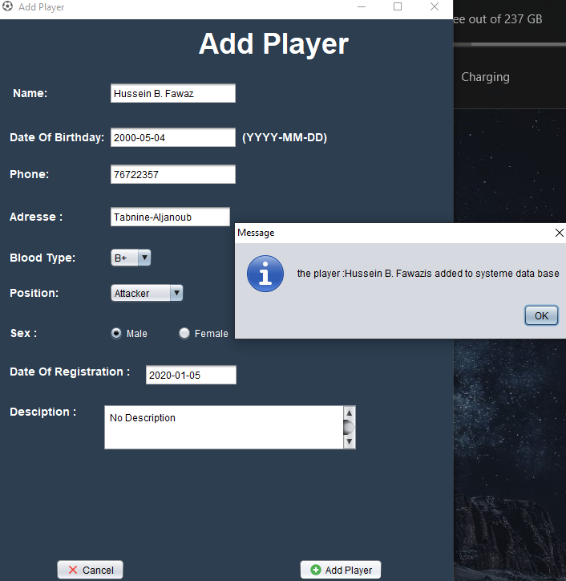
Add Player (Register a Player):
After we click on the “Add Player” button in the “Player Management” frame, a new “Add Player” frame shows up. In this frame the admin is allowed to add a player based on the specified data such as: name, date of birth, phone number, address, blood type, position (attacker, defender ..), sex, date of registration (fills up automatically with the current date), and a description. The “Add Player” button inserts the new player into the database.
A successful JoptionPane appears containing the name of the player.

Slide 11
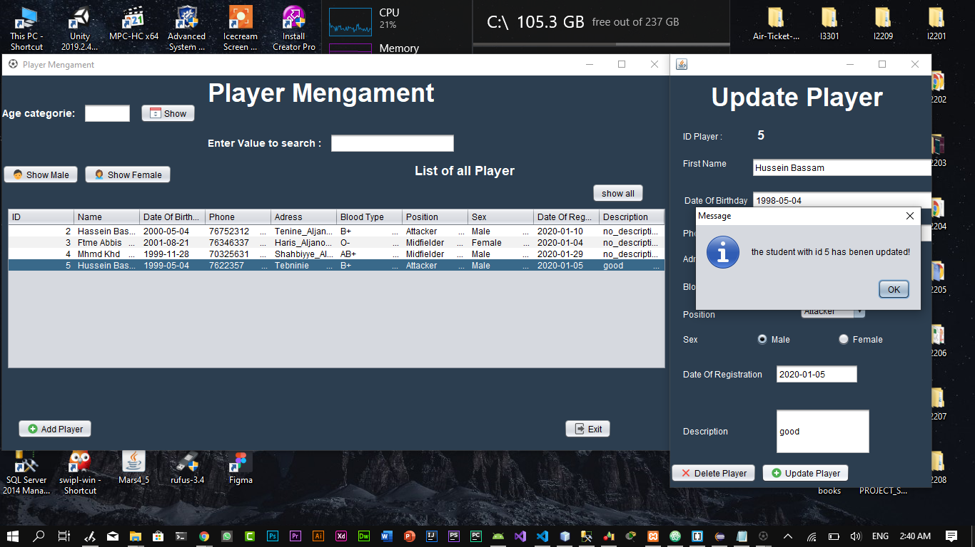
Update Player :
In the “Player Management” Frame, If the admin wants to update or delete a player, they can click on a specific row. The “Update Player” frame shows up containing all the existing data fields. The admin can now change any data field, and click “Update Player” to update the database. A JoptionPane shows up indicating a successful update.

Slide 12
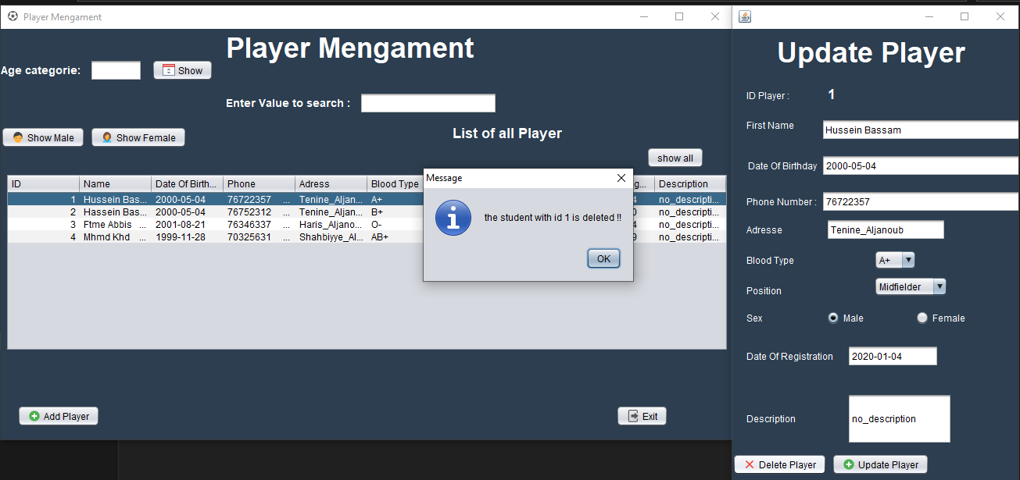
Delete Player:
As in the previous slide, the admin can click on a specific row, and the “Update Player” frame shows up containing a “Delete Player” button. The admin can click that button to delete the specified player from the database. A JoptionPane then shows up indicating a successful delete

Slide 13
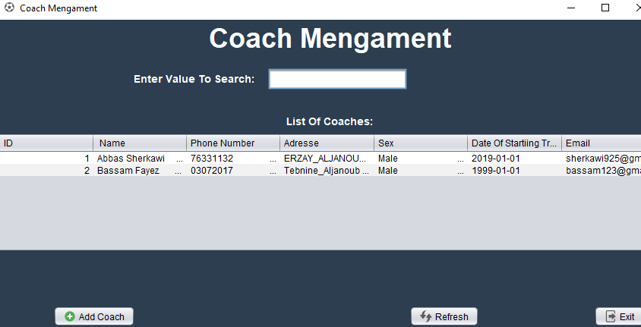
Coach Management:
When the admin clicks on the “Coach Management” button in the main frame, a new frame shows up containing all the coaches registered at the academy. This frame also contains an “Add Coach” button that allows adding a new coach, a “Refresh Button” to refresh the data, and an “Exit” button to exit the frame.

Slide 14
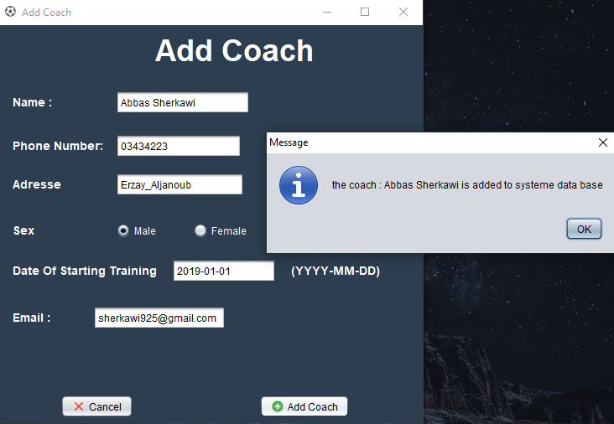
Add Coach:
After the admin clicks the “Add Coach” button in the “Coach Management” frame, the “Add Coach” frame shows up. This frame allows the admin to add a new coach to the academy. The admin enters the personal info of the new coach and clicks the “Add Coach” button to add the coach to the database. A JoptionPane then shows up containing the name of the new coach and indicating a successful registration.

Slide 15
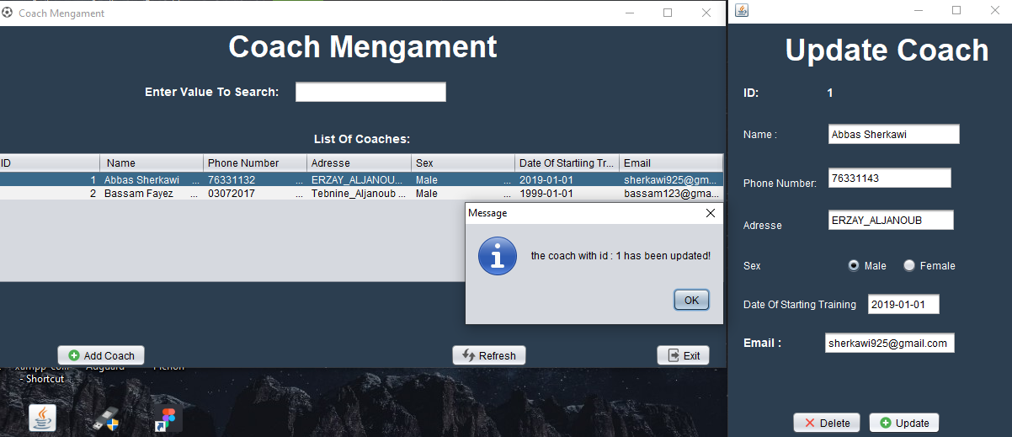
Update Coach:
In the “Coach Management” Frame, If the admin wants to update or delete a coach, they can click on a specific row. The “Update Coach” frame shows up containing all the existing data fields. The admin can now change any data field, and then click “Update” to update the database. A JoptionPane shows up indicating a successful update.

Slide 16
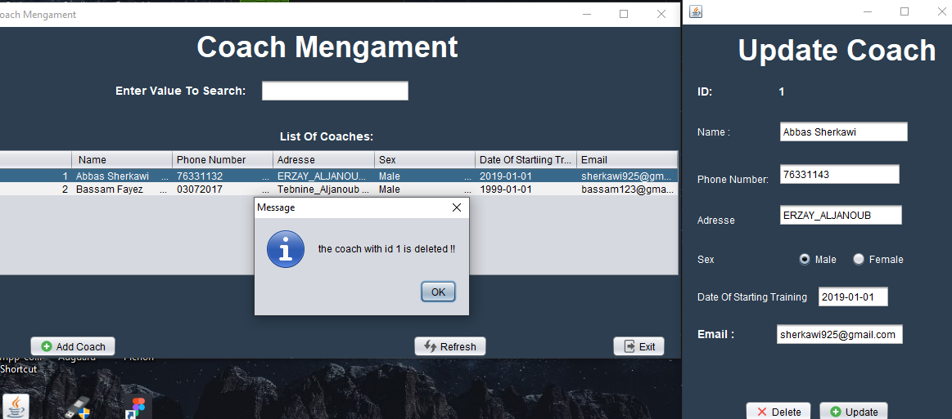
Delete Coach:
As in the previous slide, the admin can click on a specific row, and the “Update Coach” frame shows up containing a “Delete” button. The admin can click that button to delete the specified coach from the database. A JoptionPane then shows up indicating a successful delete

Slide 17
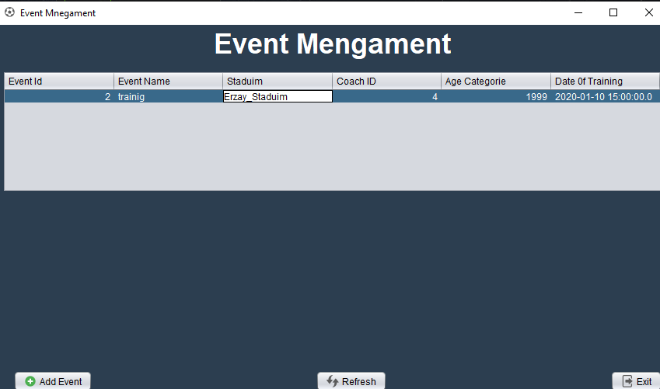
Event Management:
When the admin clicks on the “Event Management” button in the main frame, a new frame shows up containing all events created in the academy. This Frame also has an “Add Event” button to add a new event, a “Refresh” Button to refresh the data, and an “Exit” button to exit the frame.

Slide 18
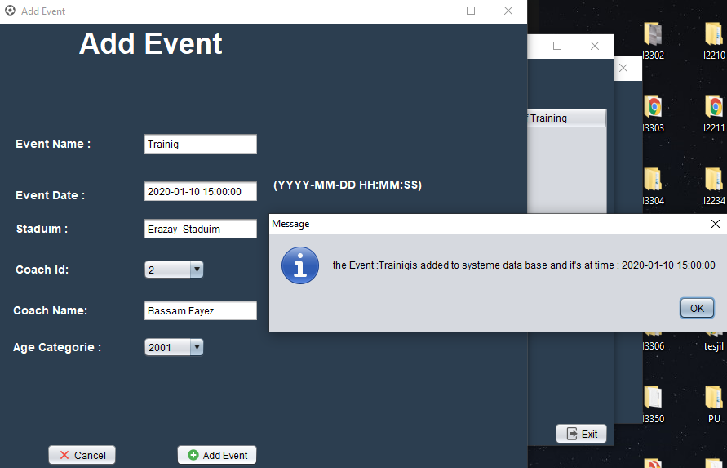
Add Event (Make an event):
When the admin clicks on “Add Event” in the “Event Management” frame, an ”Add Event” frame shows up. The admin enters the information about the new event (name, date, time, stadium, the coach ID, coach name, and the age category). The admin then clicks on “Add Event” and the event will be added to the database. A successful JoptionPane then shows up containing the name of the event and its date and time.

Slide 19
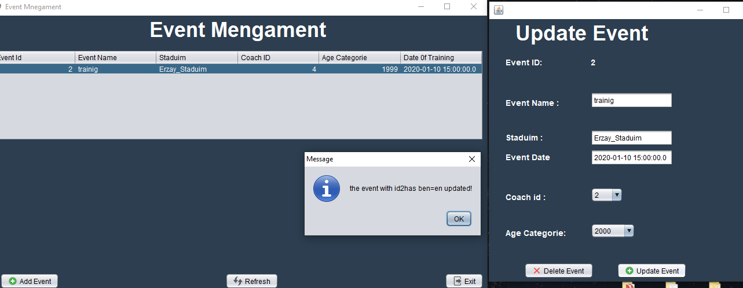
Update Event:
In the “Event Management” Frame, If the admin wants to update or delete an event, they can click on a specific row. The “Update Event” frame shows up containing all the existing data fields for that row. The admin can now change any data field, and click “Update Event” to update the database. A JoptionPane shows up indicating a successful update.

Slide 20
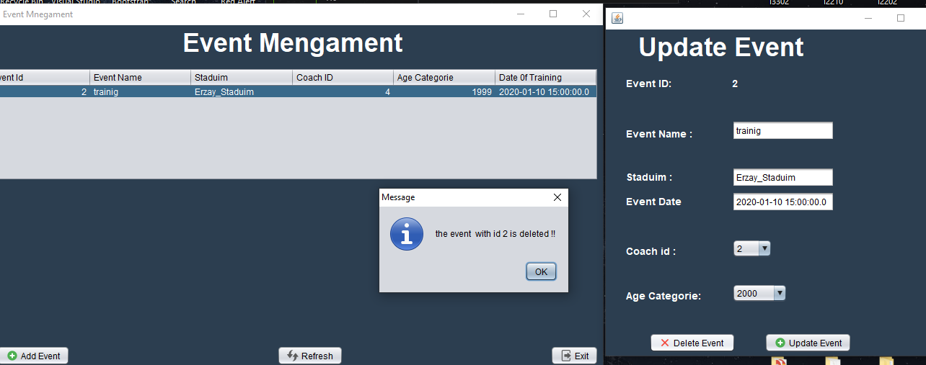
Delete Event
As in the previous slide, the admin can click on a specific row, and the “Update Event” frame shows up containing a “Delete Event” button. The admin can clicked that button to delete the specified event from the database. A JoptionPane then shows up indicating a successful delete

Slide 21
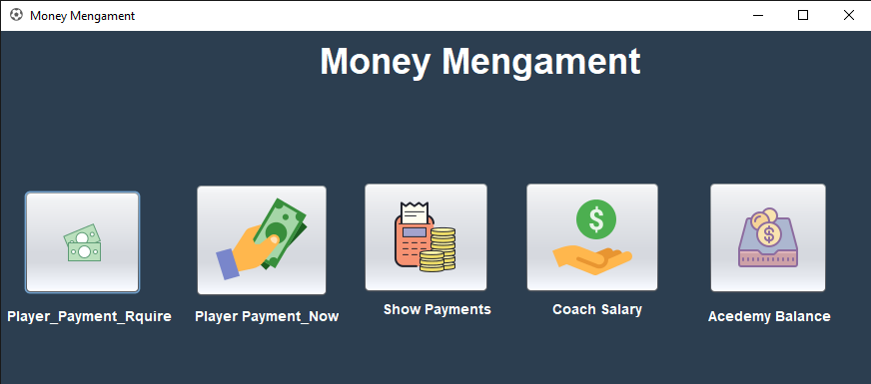
Money Management:
When the admin click on “Money Management” in the Main Frame, a new frame shows up. This frame contains:
A “Player_Payment_Require” button.
A “Player_Payment_Now” button.
A “Show Payments” button.
A “Coach Salary” button.
A “Academy Balance” button.

Slide 22
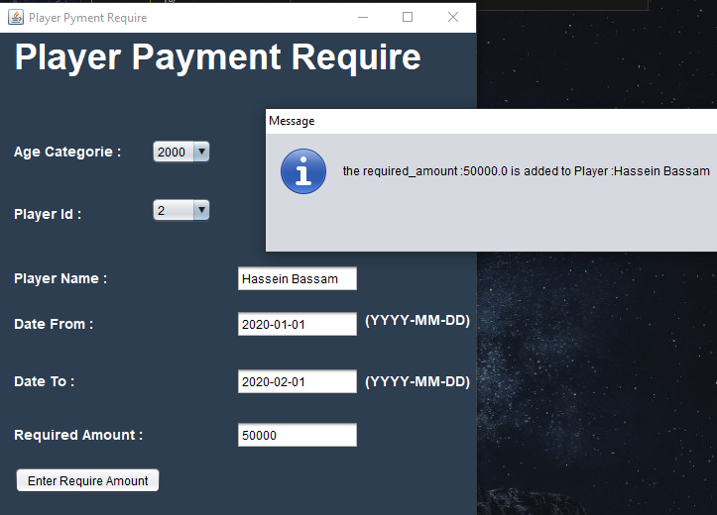
Required Amount:
After clicking on the “Player_Payment_Require” button in the “Money Management” frame, a new frame shows up. In that frame, the admin selects how much a specific player must be payed between two dates that the admin also specifies. This player is selected by first choosing the age category (2010,2011,..) (using the players in the database), and the ID of the player based on what age category is selected. The name of the player will be automatically filled in the “Player Name” text field. A JoptionPane will appear indicating a successful operation.

Slide 23
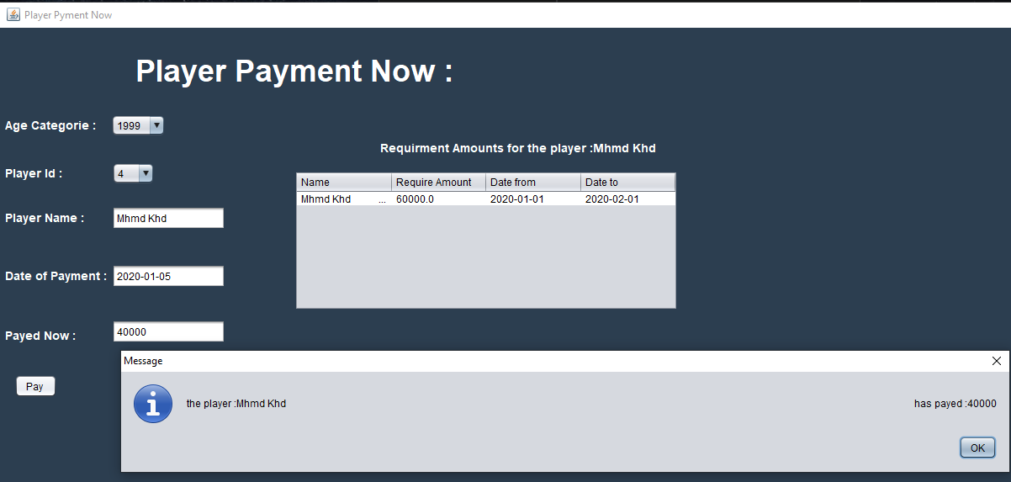
Paying Now :
After clicking on the “Player_Payment_Now” button in the “Money Management” frame, a new frame shows up. In that Frame, the admin first selects the player as in the previous slide. The info of the player will show up in a table (name, required amount, from and to dates). The admin then enters the amount to be payed now. A JoptionPane will appear indicating a successful operation.

Slide 24
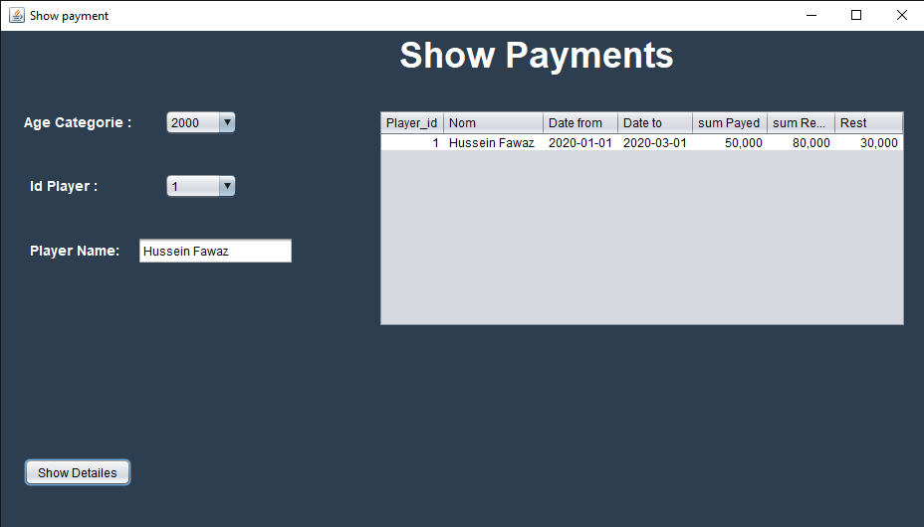
Show Payments Details:

Slide 25
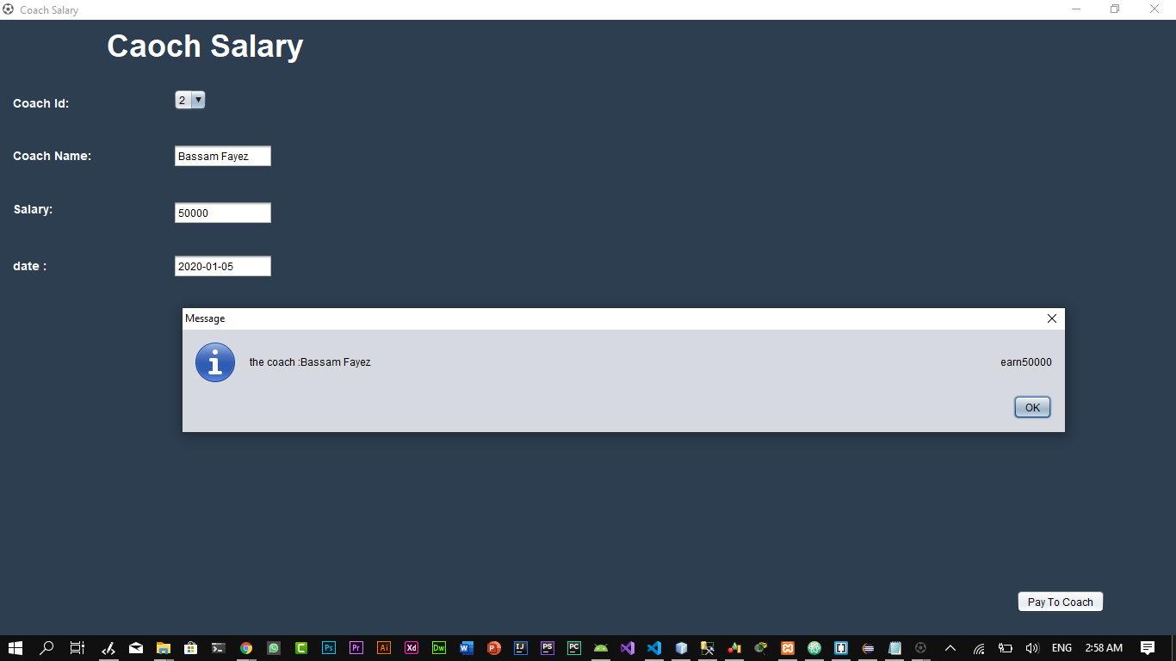
Coach Salary :
After clicking on “Coach Salary” in the “Money Management” frame, a new frame shows up. The admin uses this frame to pay the salary of a specific coach after selecting their ID (selected from database). The
name of the coach selected will be automatically filled. A JoptionPane will be appear indicating a successful operation, and the salary amount will be deducted from the total amount of money in the academy.

Slide 26
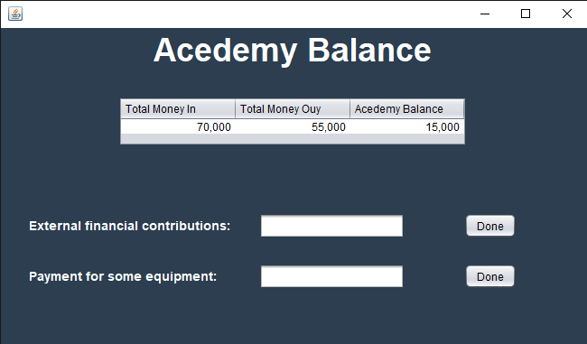
Academy Balance :
This Frame Contains a table that has 3 columns:
- “Total Money In” showing the total amount of money received by the academy (from player payments and external contributions, etc.).
- “Total Money Out” showing the total amount of money payed (salaries of coaches, equipment cost, etc.).
- “Academy Balance” showing how much money the academy currently has.

Slide 27
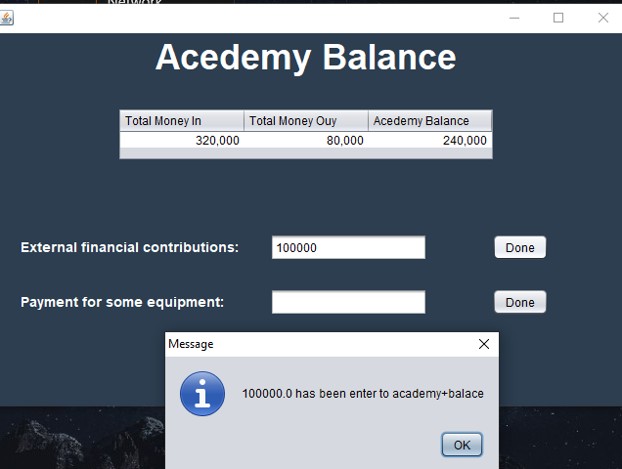
External contribution:
In this frame, when an external contribution
Is received by the academy, the admin enters the amount in the designated field and presses “Done”. The money will then be added to the academy balance. A JoptionPane appears indicating a successful operation.

Slide 28
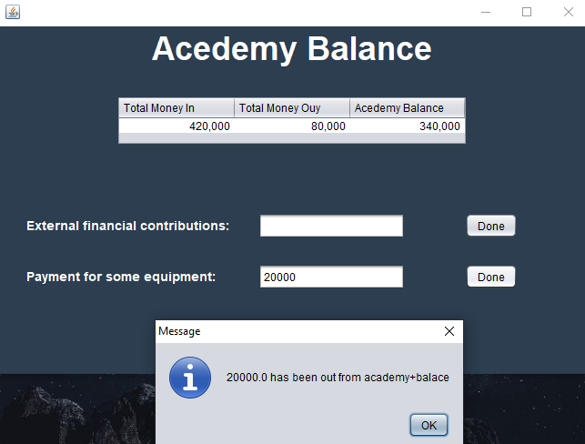
Payment for some equipment:
In this frame, when the admin wants to pay for some equipment (balls, etc…), they can enter the amount in the designated field and press “Done”, And the money will be deducted from the academy balance. A JoptionPane appears to show a successful operation.

Slide 29
THANK YOU FOR YOUR ATTENTION
FINISH ☺

